Slide 1
Richmond Discipline
Process, Forms and Procedures

Slide 2
Richmond School uses a school-wide discipline system using refocus forms, detentions, demerits, and suspension (on and off campus).
Restorative Justice is utilized when appropriate.
In addition, each classroom has rules and guidelines appropriate to the age level of the students.

Slide 3
Consequences begin with a discussion and explanation of a rule being broken.
The student may also be asked to complete a “Refocus Form”, or may be removed from an activity.
The refocus form is an age appropriate document that allows The student to reflect on their behavior or actions. Teachers have the opportunity to further investigate the student’s actions utilizing the document and come to a resolution.

Slide 4
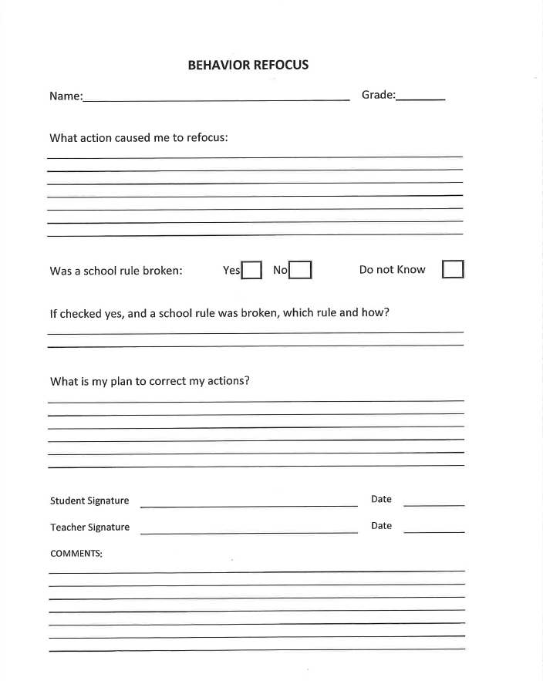
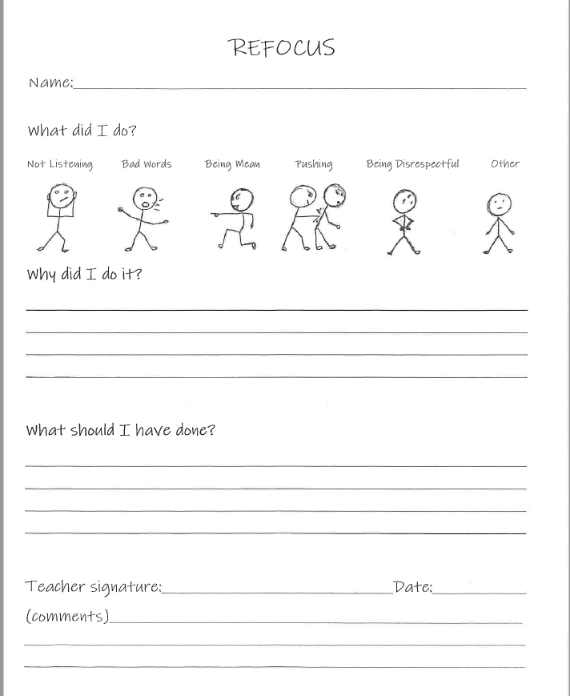
Examples of refocus forms for upper and lower grades

Slide 5
Refocus forms are documented and tracked. Each form is given a code:
PC- physical contact, IB- Inappropriate behavior, T-Throwing, IL- Inappropriate Language, P- property misuse, DC- disrupting Class, S- sportsmanship
Student conferences are initiated after a student receives 3 or more refocus forms for the same code.

Slide 6
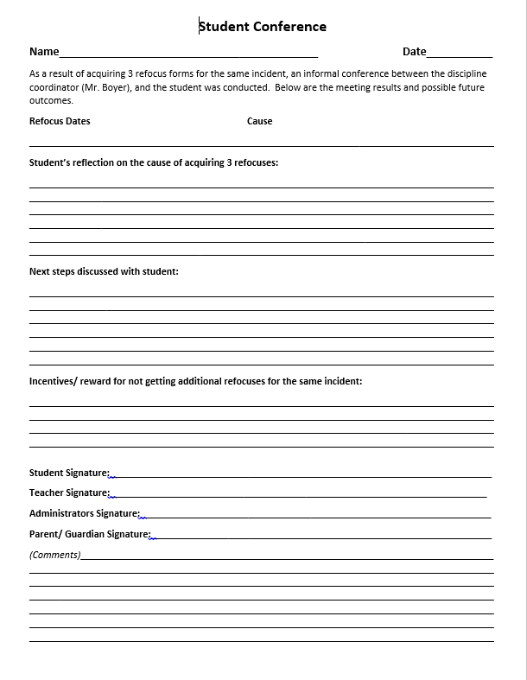
conference Form
Allows the student to reflect on their behavior and provide input
Gives the student ownership of their behavior and how it can be corrected
Teacher is able to reinforce a desired outcome
Student gives suggestions for progressive consequences if behavior continues
Allow for incentives if the behavior improves and/or is not repeated
Signatures ensure the student agrees, teachers and administration is informed, parents are informed with comments encouraged

Slide 7
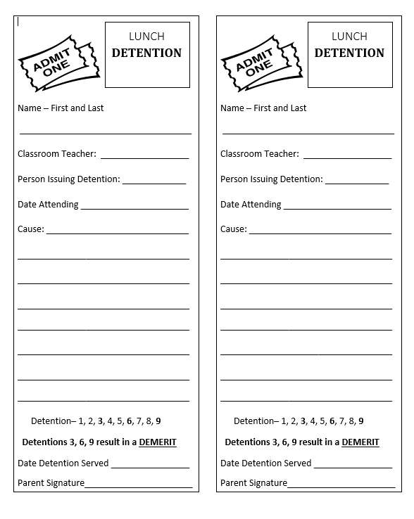
DETENTIONS
Can be given immediately by any staff member
Detentions are served during lunch in the designated area
Detention notice is sent home, requiring a parent signature
Detentions may result in lost privileges; including participation in leadership, sports, assemblies, pep rallies, etc.
Restorative Justice can be utilized at the discretion of the teacher and student

Slide 8
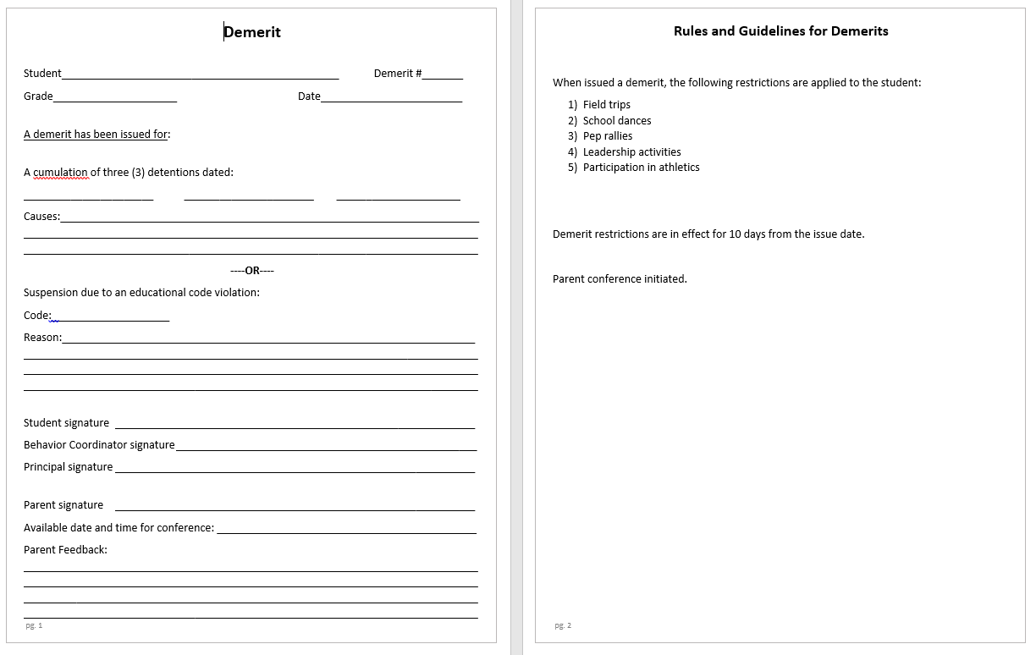
Demerits
Will be issued if a student received 3 detentions (a demerit for every 3 detention that follows)
Will be issued as a result of a Educational Code violation that resulted in a suspension
Consequences that follow a demerit include loss of privileges for 10 calander days(not including holidays); including pep rallies, non educational assemblies, sports, and field trips
Parent contact is completed and a conference is strongly encouraged

Slide 9
On campus/ Off campus suspensions
Suspensions are only given to students from the administrator. The student receives a suspension as a result of an Educational Code violation. A student receiving an on campus suspension will report directly to the office to begin their “Structured Day”.
Parent/Guardians are contacted, classroom teacher is notified, suspension rate is reported within the school SARC report.

Slide 10
Structured Day process/ procedure (for on campus suspensions)
Administration:
Suspension is inputted into School Wise
Suspension letter is given to the student/ copy for parent/guardian
Phone call is made to parent/guardian informing of OCS
Classroom Teacher:
Prepare all materials for the student, including missing assignment sheet
Ensure all materials are delivered to the office for morning pick up
Cafeteria Staff:
Prepare breakfast and lunch to be delivered to the student serving OCS
OCS Classified Staff:
Ensure an area is free for student to utilize while serving OCS (library)
Ensure coverage is available for the student
Plan A: Librarian Plan B: Two Classified rotation
Structured Day Schedule and Procedure
Upon entering onto school grounds, the student will report directly to the office to sign in and pick up all materials for the day. The student will remain supervised in the office until the OCS room (library) is available, at which time the student will be escorted to the library. The student will remain in the library the entire day and will not be permitted to leave for any reason. This includes attending recesses with others, breaks around other students, trips back to their classroom, breakfast and lunch, etc. Breakfast and lunch will be brought to the student serving OCS. Bathroom breaks will be only permitted utilizing the facilities in the library.

